Slide 1
Chapter 1
Introduction to Python for data analysis

Slide 2
Objectives
Applied
Write Python statements that
import a module
call and chain methods
use slices, lists, tuples, dictionaries, and list comprehensions
Use JupyterLab to
open an existing Notebook or to start a new Notebook
edit and run the cells of a Notebook
create and modify the headings in a Notebook
Use JupyterLab’s Tab completion and tooltip features.
Use JupyterLab’s Magic Commands to time statements and display the current variables.

Slide 3
Objectives (continued)
Knowledge
Describe data analysis and data visualization.
List the five phases of data analysis and visualization.
Describe the Pandas and Seaborn modules that are in the Anaconda distribution.
Distinguish between runtime errors and syntax errors.

Slide 4
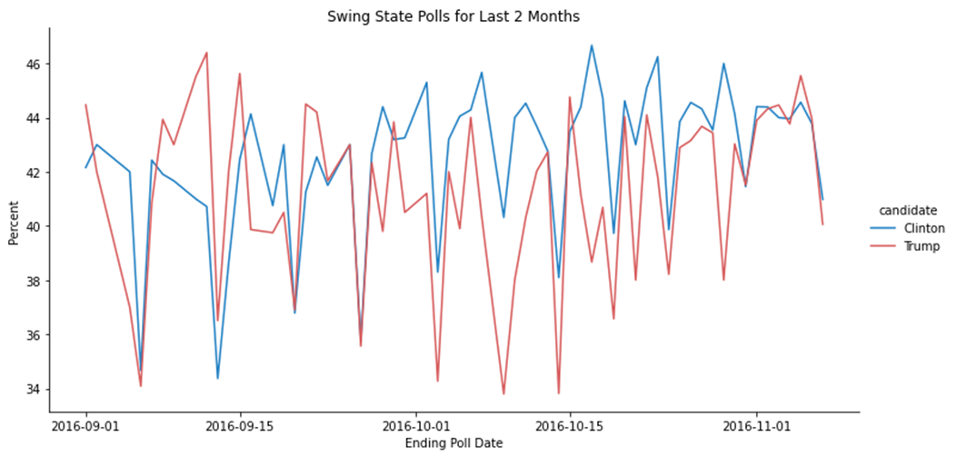
Data visualization often provides the best insights into the data

Slide 5
What data analysis includes
Data analysis
Data visualization (data viz)
Data modeling (predictive analysis)
Related terms
Data analytics
Business analytics
Sports analytics

Slide 6
What to do before starting an analysis
Set your goals
The goals of analysis can be well-defined, like trying to answer specific questions, or more general, like trying to extract useful information from large volumes of data.
Define your target audience
If you’re going to present your findings to other people like managers or clients, you also need to define your target audience before you start your analysis.

Slide 7
The five phases of data analysis and visualization
Get the data
Find the data on a website or in one of your company’s databases or spreadsheets.
Read the data into a DataFrame or build a DataFrame from the data.
Clean the data
Remove unnecessary rows and columns.
Handle invalid or missing values.
Change object data types to datetime or numeric data types.

Slide 8
The five phases of data analysis and visualization (continued)
Prepare the data
Add columns that are derived from other columns.
Shape the data into the forms that are needed for your analysis.
Make preliminary visualizations to better understand the data.
Analyze the data
Get new views of the data by grouping and aggregating.
Make visualizations that provide insights and show relationships.
Model the data as part of predictive analysis.
Visualize the data
Enhance your visualizations so they’re appropriate for your target audience.

Slide 9
Three of the IDEs for Python data analysis
Jupyter Notebook
JupyterLab
VS Code
Our recommendations for Python distributions and IDEs
Use the Anaconda distribution of Python.
Use JupyterLab as your IDE.

Slide 10
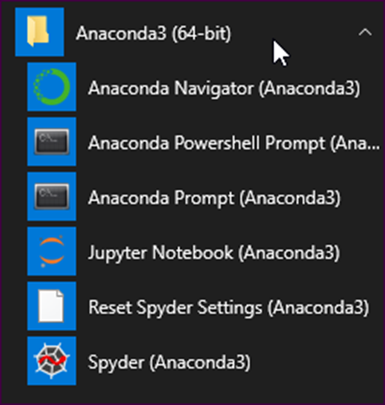
The programs that are installed by the Anaconda distribution

Slide 11
Modules included with the Anaconda distribution
Module | Abbreviation | Provides methods for
pandas | pd | Data analysis and visualization
numpy | np | Numerical computing
seaborn | sns | Data visualization
datetime | dt | Working with datetime objects
urllib |  | Getting files from the web
zipfile |  | Working with zip files
sqlite3 |  | Working with a SQLite database
json |  | Working with JSON data
sklearn |  | Regression analysis

Slide 12
The modules you need to install for this book
Module | Chapter | Provides methods for
pyreadstat | 5 | Reading Stata files
geopandas | 12 | Plotting geographic data
Two ways to install a module
Use the conda command from the Anaconda prompt
conda install pandas --yes
Use the conda command with a different channel
conda install –-channel conda-forge pyreadstat --yes

Slide 13
How to import modules
How to import one module into the namespace specified by the as clause
import pandas as pd
How to import one submodule from a module
from urllib import request

Slide 14
How to call methods
How to call a method in a module
import pandas as pd
polls_url = \
'http://projects.fivethirtyeight.com/.../president_general_polls_2016.csv' polls = pd.read_csv(poll_url)
How to call a method from a DataFrame object
polls.sort_values('startdate')

Slide 15
How to chain methods
How to chain the sort_values() and head() methods
polls.sort_values('startdate').head()
How to chain the query() and plot() methods
polls.query('state != "U.S."') \
.plot(x='startdate', y=['Clinton_pct','Trump_pct'])

Slide 16
How to call a method with positional and keyword parameters
The signature for the sort_values() method
sort_values(by, axis=0, ascending=True, inplace=False,
kind='quicksort', na_position='last')
The sort_values() method with positional and keyword parameters
polls.sort_values('startdate', ascending=False, inplace=True)

Slide 17
The syntax for coding lists, slices, tuples, and dictionary objects
A list is a sequence of items within brackets
[item1,item2,...]
A tuple is coded like a list but in parentheses
(item1,item2,...)
A dictionary is a sequence of key/value pairs within braces
{key1:value1, key2:value2, ...}
A slice sets the start and stop values and an optional step value
start:stop:step

Slide 18
How to use lists, slices, tuples, and dictionary objects
A list used as a keyword parameter
polls.drop(columns=['cycle','branch','matchup','forecastdate'],
inplace=True)
A tuple used as a keyword parameter
polls.plot.line(xlim=('2016-06','2016-11'))
A dictionary used as a keyword parameter
polls.rename(columns={'adjpoll_clinton':'Clinton',
'adjpoll_trump':'Trump'})
Two slices used in a loc[ ] accessor
polls.loc[0:100:10,'state':'grade']

Slide 19
How to code a list comprehension
The syntax
[expression for member in iterable]
A list comprehension used to provide the list for a keyword parameter
xticks = [x for x in range(1900,1920,2)]
The resulting list
[1900, 1902, 1904, 1906, 1908, 1910, 1912, 1914, 1916, 1918]

Slide 20
Two ways to continue a statement
With implicit continuation
polls.sort_values(
['state','startdate'],
ascending=False,
inplace=True)
With explicit continuation
polls.sort_values(['state','startdate'], \
ascending=False, \
inplace=True)

Slide 21
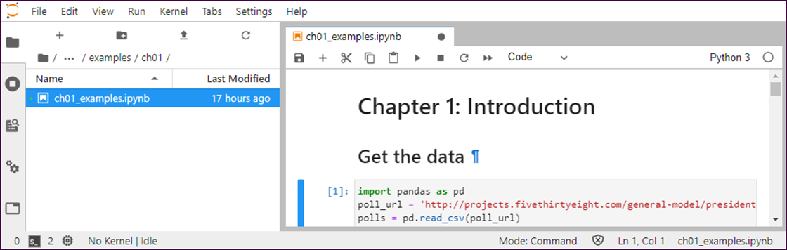
One Notebook in JupyterLab with the File Browser open

Slide 22
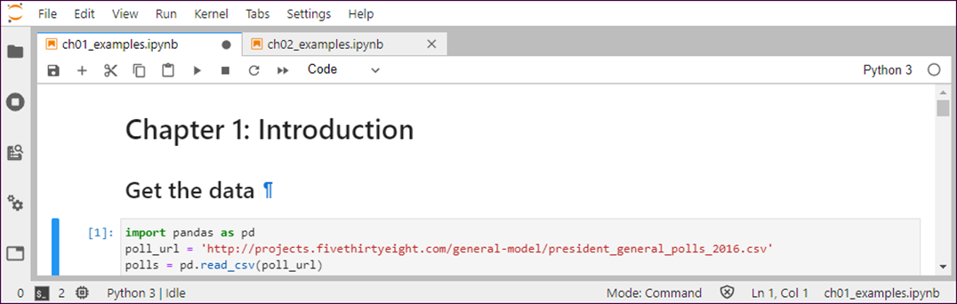
Two Notebooks in JupyterLab with the File Browser closed

Slide 23
How to start JupyterLab
Use the Start menu to start the Anaconda Navigator, and then launch JupyterLab.
How to work with Notebooks
To open or close the File Browser, click the File Browser icon in the upper left corner.
To open a Notebook, browse to the file you want to open and double-click on it.
To start a new Notebook, select File→New Launcher to open a Launcher tab. Then, click the Python 3 icon.
To save, close, or rename a Notebook, use the File menu. To save the active Notebook, click on the Save icon in the toolbar for the tab.
To restore a Notebook to the last checkpoint, select File→Revert Notebook to Checkpoint.

Slide 24
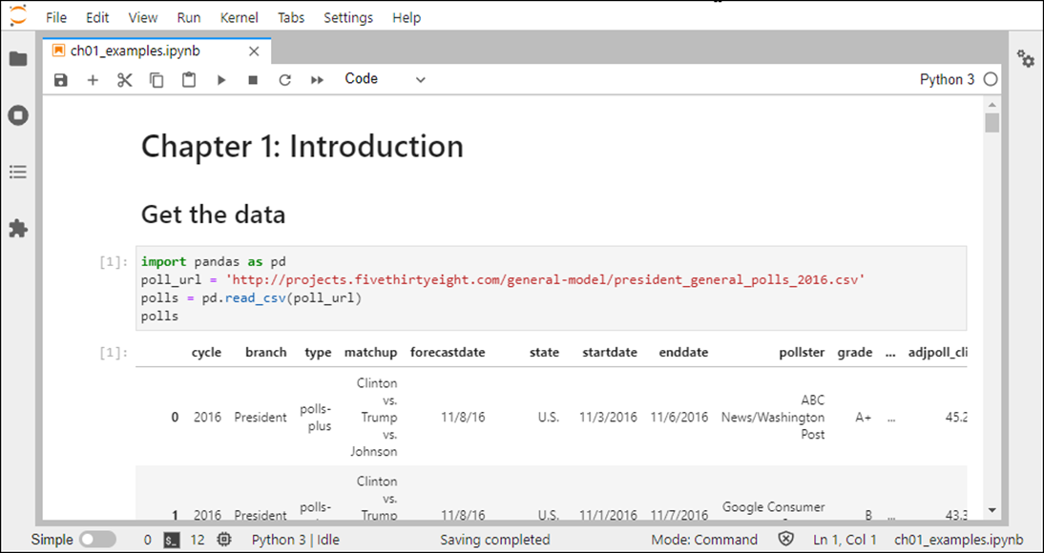
A cell and its output when the cell is run

Slide 25
How to select one or more cells
To select one cell, position the pointer in the left margin of the cell so it becomes a crosshair, and then click so a blue line is displayed.
To select more than one cell, select the first cell, hold down the Shift key, and select the last cell.
How to copy, delete, merge, or move the selected cells
Use the buttons in the toolbar or the items in the Edit or shortcut menu.
How to add a cell after the current cell
Use the + button in the toolbar.

Slide 26
How to run the code in one cell
Press Shift+Enter or click the Run button in the toolbar.
How to run the code in selected cells or all cells
Use the Run button in the toolbar or the items in the Run menu.
How to interrupt, restart, or shutdown the kernel
Use the items in the Kernel menu.

Slide 27
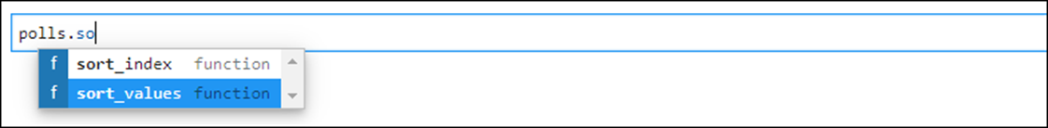
The Tab completion feature is activated when you press the Tab key

Slide 28
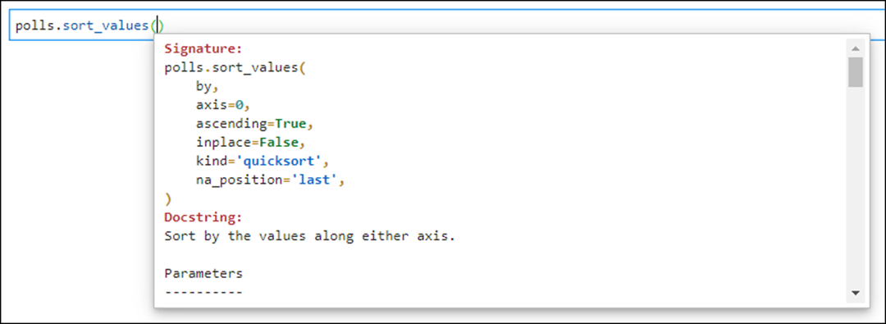
The tooltip feature is activated when you press the Shift+Tab key
The start of the tooltip for the sort_values() method

Slide 29
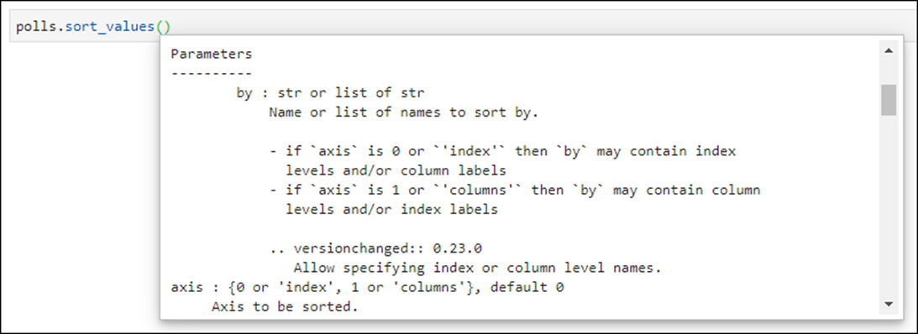
The tooltip feature (continued)
More of the tooltip after scrolling down to the start of the parameters

Slide 30
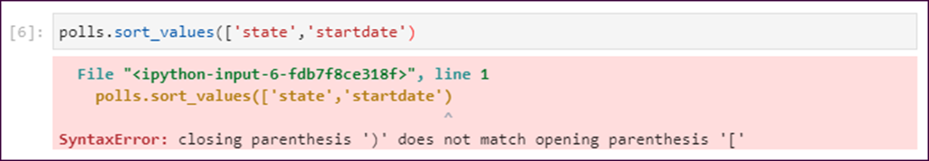
A syntax error in a Notebook

Slide 31
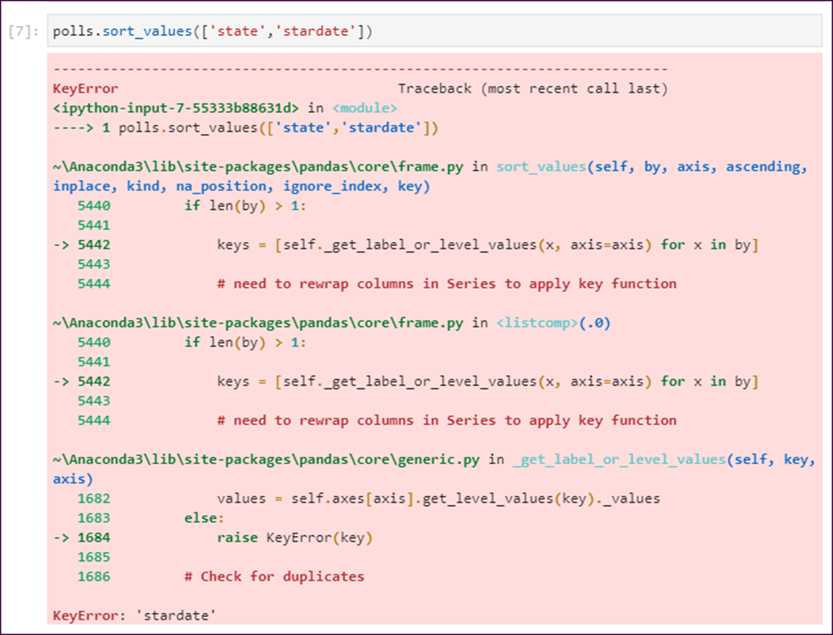
A runtime error in a Notebook

Slide 32
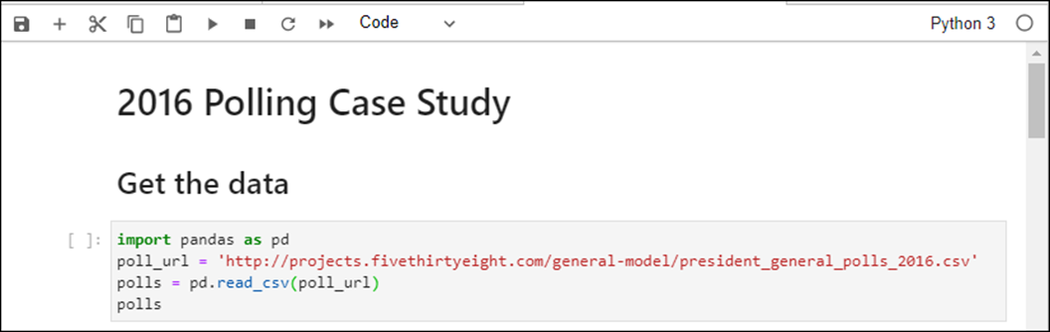
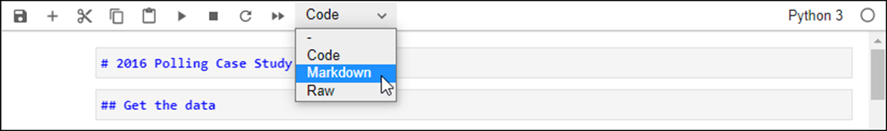
A Notebook with headings
The Markdown language for the headings

Slide 33
How to create a heading by using Markdown language
With the cursor in a new cell, change the drop-down list from Code to Markdown.
Type the text for a heading into the cell preceded by from one to five # signs. The number of signs determines the level of the heading.
Run the cell to convert the Markdown language to the heading.
How to modify a heading in a Notebook cell
Double-click in the cell to display the Markdown language, modify it, and run the cell.

Slide 34
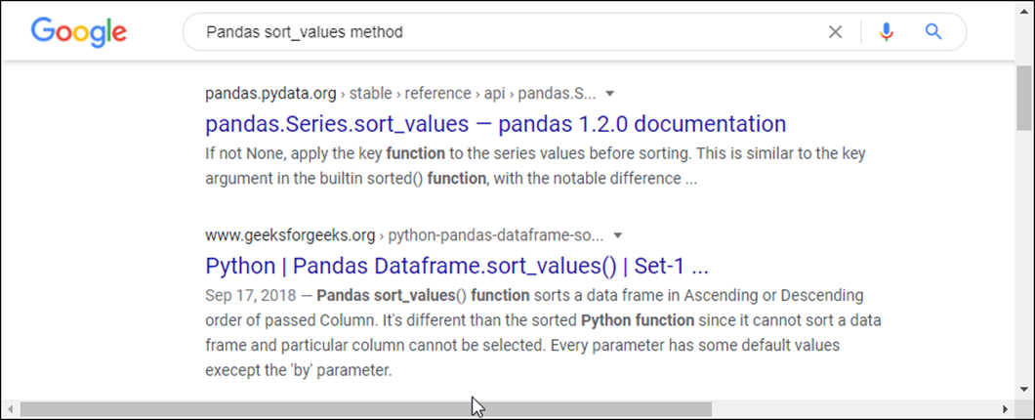
A search for the Pandas sort_values() method

Slide 35
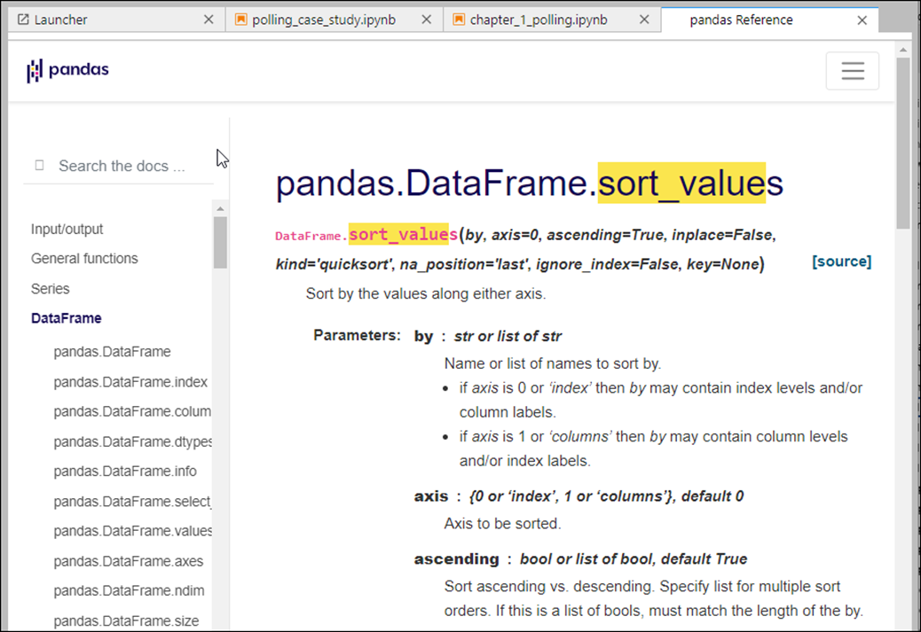
The JupyterLab Help menu and a page in the Pandas reference

Slide 36
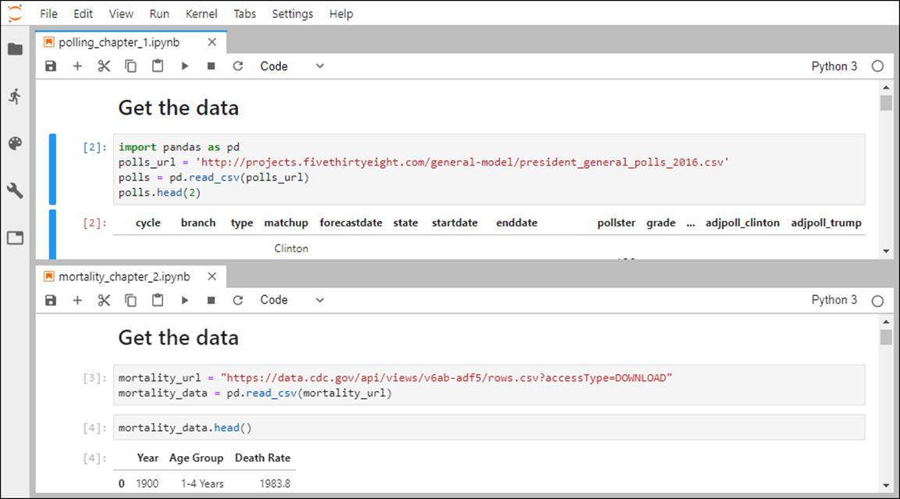
JupyterLab with two Notebooks in a horizontally split screen

Slide 37
How to split the screen
To split the screen vertically between two open Notebooks, drag the second tab down and to the right and drop it.
To split the screen horizontally between two open Notebooks, drag the second tab down and drop it.
How to restore the screen
Drag the tab of the bottom or right Notebook until it’s next to the tab of the other Notebook and drop it.
If you have trouble restoring the screen by dragging the split tab, you can close one of the Notebooks and then reopen it.

Slide 38
Four of the most useful Magic Commands
Command | Description
%time | Displays the time that it takes for a statement to run.
%%time | Displays the time that it takes for all the statements in a cell to run.
%whos | Displays the variables that are in the namespace along with their data types.
%magic | Displays a reference for all of the Magic commands.

Slide 39
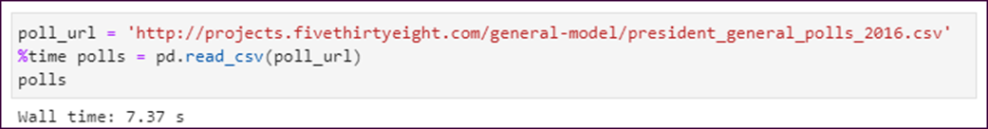
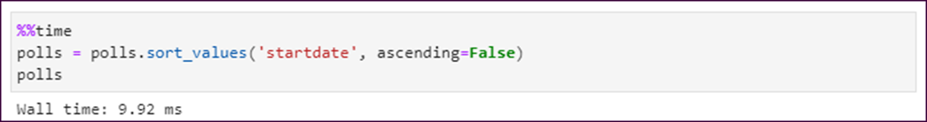
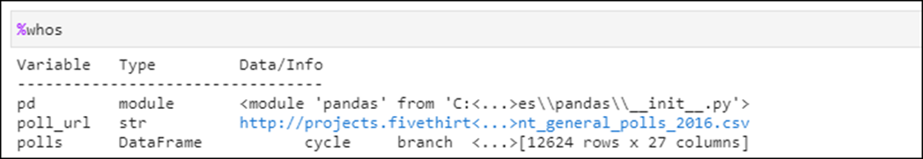
How the %time command works
How the %%time command works
How the %whos command works

Slide 40
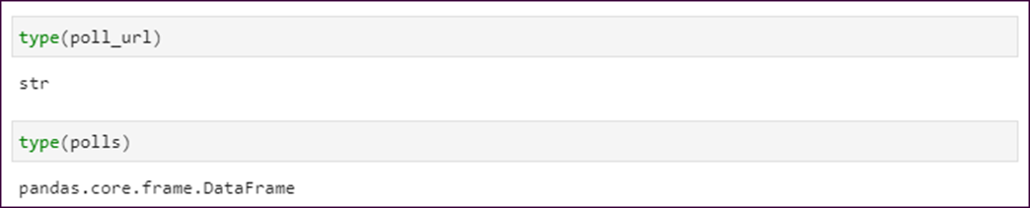
How to use the Python type() function to check the data type of a variable

Slide 41
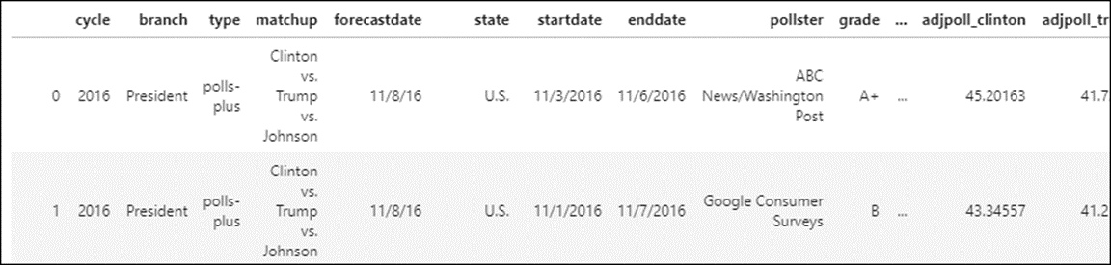
The URL for the Polling data
http://projects.fivethirtyeight.com/general-model/ president_general_polls_2016.csv
The imported DataFrame (12,624 rows and 27 columns)

Slide 42
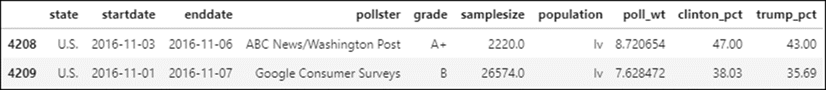
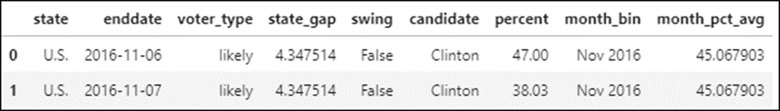
The cleaned DataFrame (4,116 rows and 10 columns)
The prepared DataFrame (8,232 rows and 9 columns)

Slide 43

A Seaborn plot of the swing state polls in the 2 months before the election

Slide 44
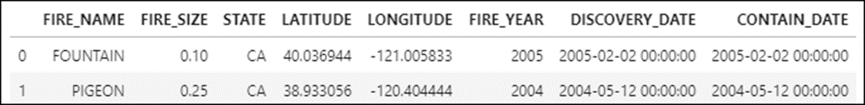
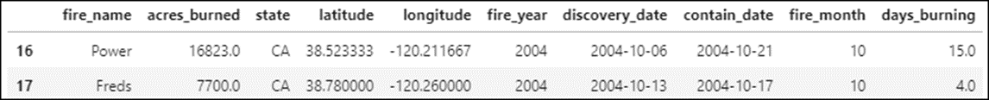
The URL for the Fires data
https://www.fs.usda.gov/rds/archive/products/RDS-2013-0009.4/ RDS-2013-0009.4_SQLITE.zip
The imported DataFrame (1,880,465 rows and 8 columns)
The prepared DataFrame (247,123 rows and 10 columns)

Slide 45
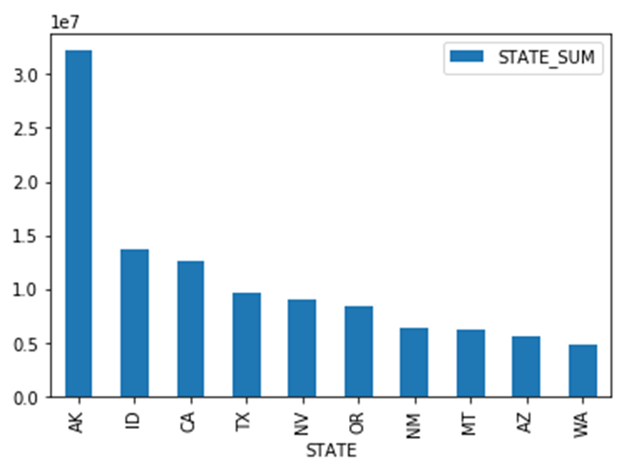
A Pandas plot of the total acres burned in the top 10 fire states in 2015

Slide 46
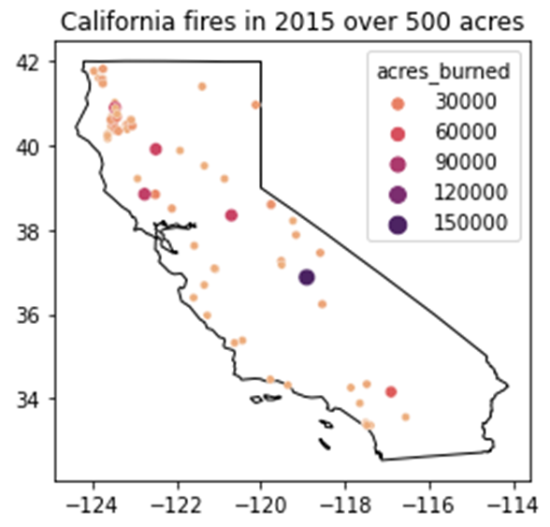
A GeoPandas and Seaborn plot of the California fires over 500 acres in 2015

Slide 47
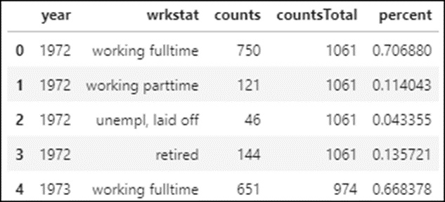
The URL for the Social Survey data
http://gss.norc.org/Documents/stata/gss_stata_with_codebook.zip
The starting dataset
64,814 rows and 6,110 columns
This dataset is so large that importing it requires 3 gigabytes of memory. So instead of importing the entire file, you should import just the subsets of data that you need for your analyses.
One of the DataFrames that’s prepared for analysis (128 rows, 5 columns)

Slide 48
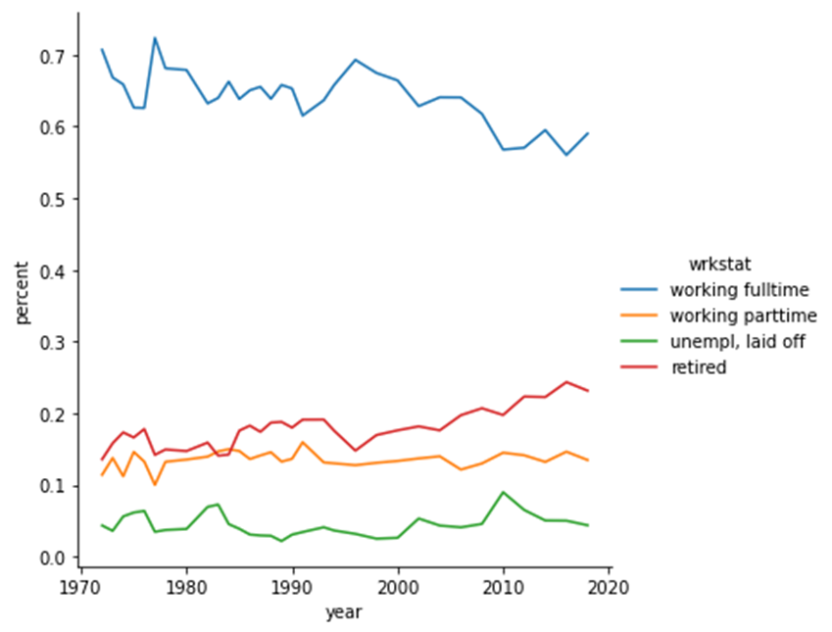
A Seaborn plot derived from the DataFrame

Slide 49
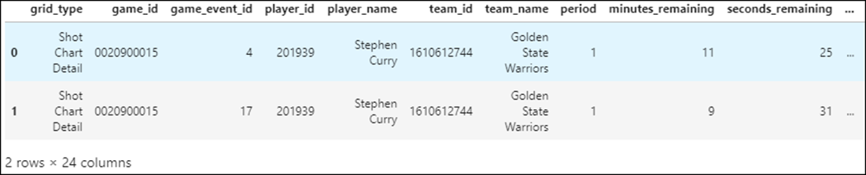
The URL for the Sports Analytics data
https://www.murach.com/python_analysis/shots.json
The imported DataFrame (11,846 rows and 24 columns)

Slide 50
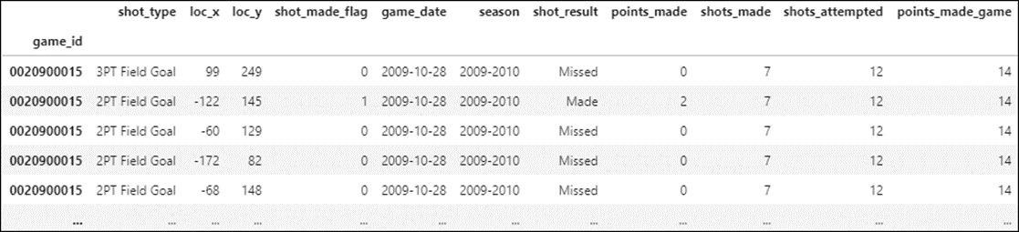
The prepared DataFrame (11,753 rows and 12 columns)

Slide 51
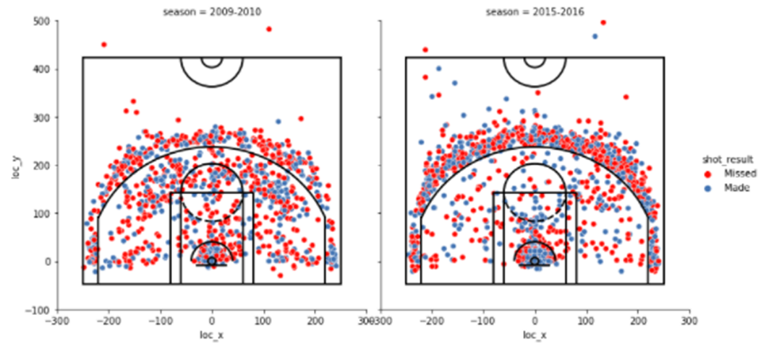
A Seaborn plot for how Curry’s shot selection changed

